Slide 1
IT POS Check In Presentation
FEDORA THE EXPLORERS:
KYLE RIEDEMANN, HALI DEUBLER, KEITH WRIGHT, TRAVIS DEVER, AARON WRIGHT

Slide 2


INTRODUCTION
Geekabytes
Local company
Computer, Network, and Website services

Slide 3

REQUEST
Need clock-in system for on-site workers
Need a way to track on-site jobs

Slide 4



SOLUTION
Android application
Handles clock-in/out and job tracking functions
Integrates with current systems

Slide 5

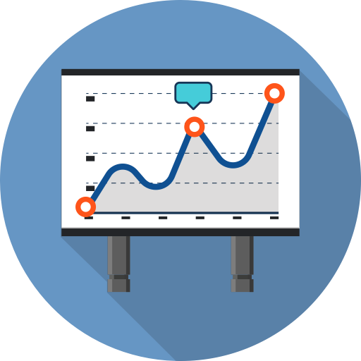
BENEFITS
App free for employee download
Accessible from anywhere
Low/no training required

Slide 6
BENEFITS
More modern and reliable than current system
Saves travel time and money
Access to source code for easier maintenance

Slide 7
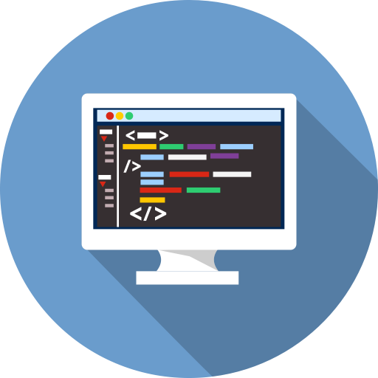
BENEFITS
More modern and reliable than current system
Saves travel time and money
Access to source code for easier maintenance

Slide 8
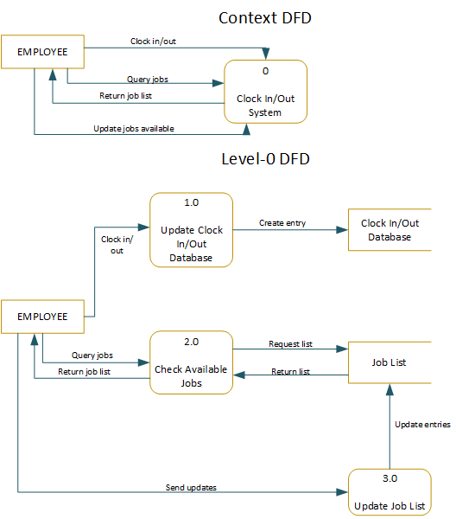
LOGICAL DESIGN
This illustrates at a high level what behavior the system encapsulates.
Employees will clock in, see the list of things to work on, and clock out when they are done

Slide 9
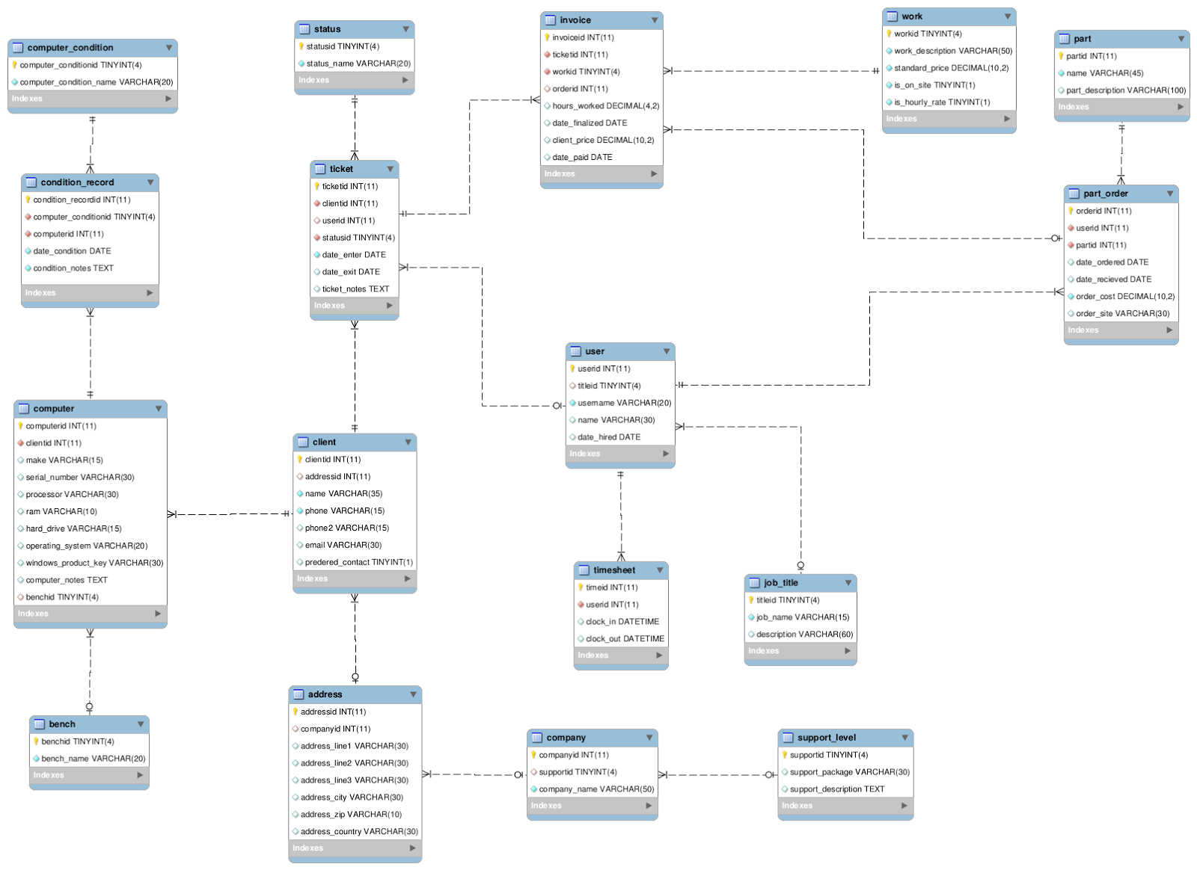
This is the ERD for the full Geekabytes database.
The limited scope of our project means that we only deal with a few of the tables.
CONCEPTUAL DESIGN

Slide 10
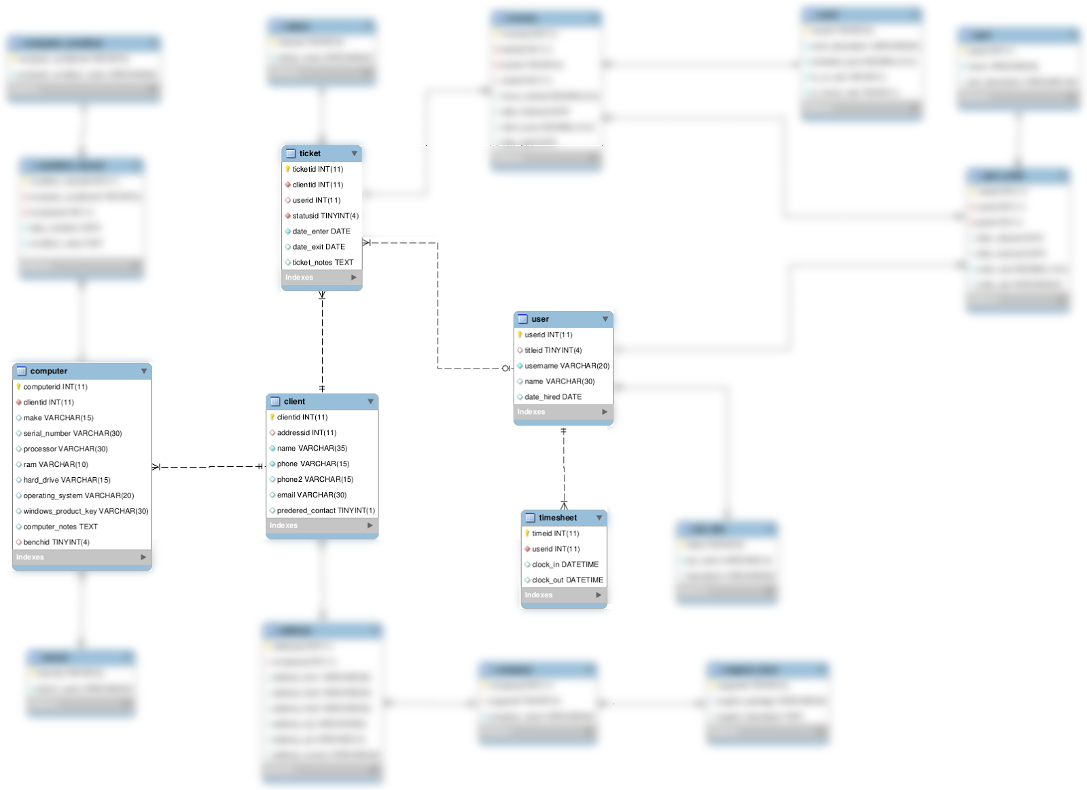
The unblurred tables show the part of the database that our application interacts with.
Our app makes GET requests about the computer, ticket, client, and user tables, and POST requests to the update the timesheet table.
CONCEPTUAL DESIGN

Slide 11
Django REST API
curl -X POST -H "Accept: appname=Kyle Riedemann" -F "clock_in=2014-11-29T14:29:00Z" -F "clock_out=2014-11-29T16:30:00Z" "http://ip_address:port/timesheet/"
Above is an example of the API usage that will post the data “Kyle Riedemann clocked in at 2:29 pm and clocked out at 4:30 pm on November 29th, 2014
Formatted JSON is sent for the Django API to interpret, and then it updates the MySQL database

Slide 12
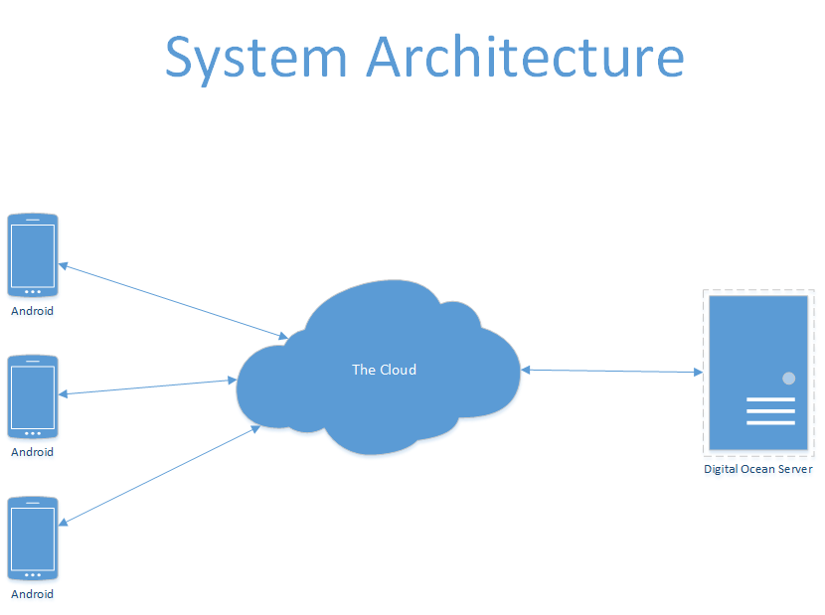
Our database runs on a MySQL server hosted on a Digital Ocean droplet in New York.
The phone application interacts with the server through a Django API.
PHYSICAL DESIGN

Slide 13
Our database is used as a persistent store of application state, and all interaction with the database is made through the Django API.
This de-emphasises the mathematical logic behind the relational database, and lets us create front end applications quickly without database management getting in the way.
PHYSICAL DESIGN

Slide 14
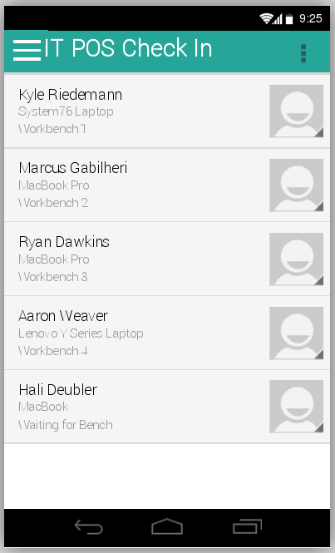
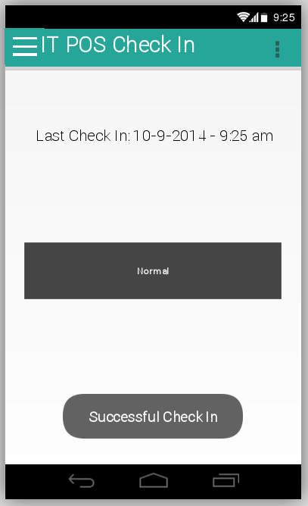
DESIGN MOCKUP
These mockups were made with popular wireframing tool fluidui.com
The quality of these mockups is in no way reflective of Kyle Riedemann’s design skills

Slide 15
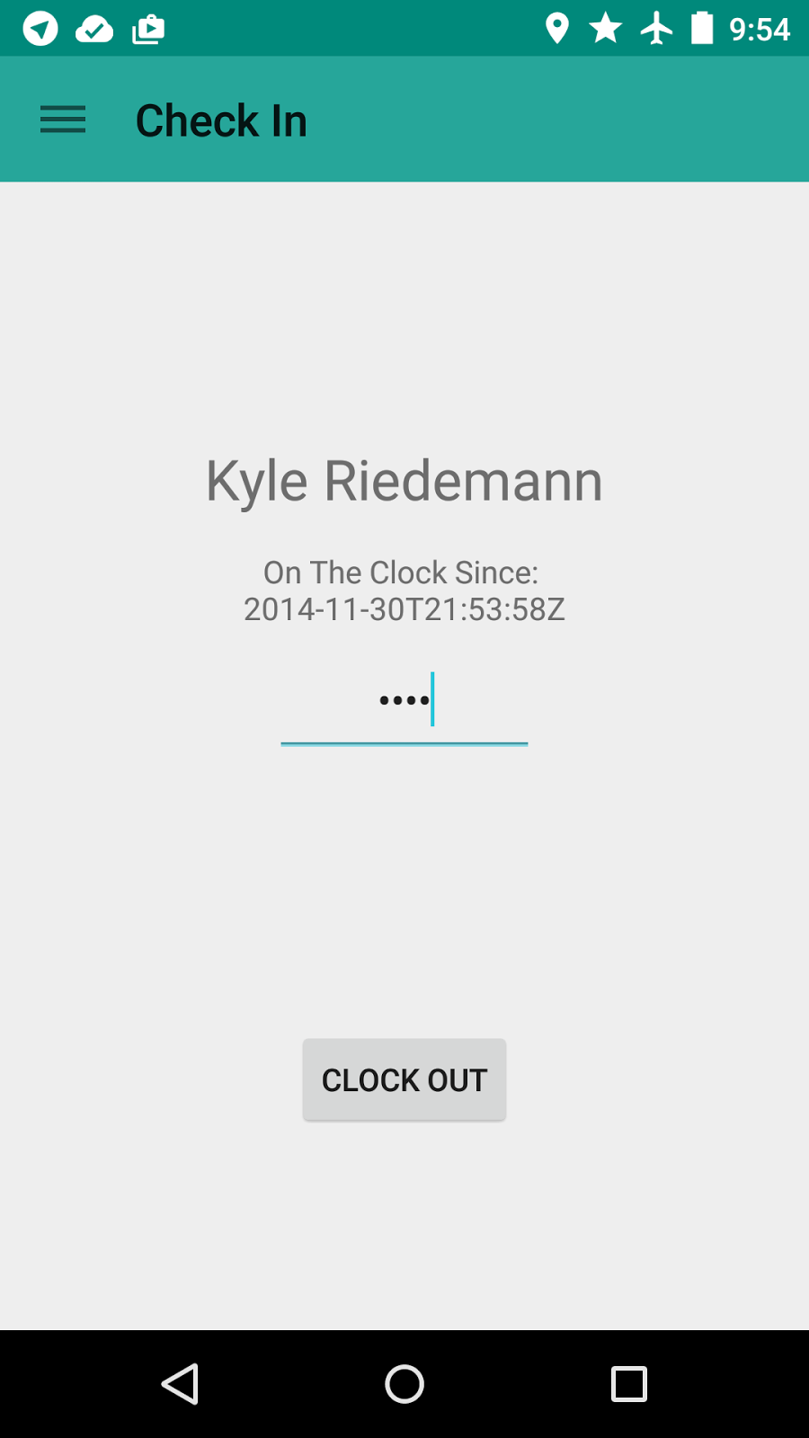
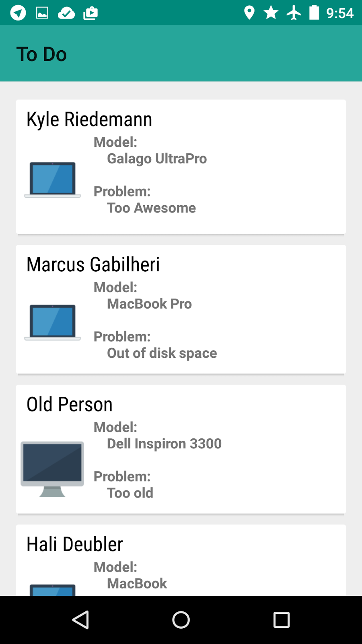
Conforms to new Material Design Guidelines
Stone branding through the use of color
Uses card view to visually group information
All icons are publically available under the Creative Commons 3.0 license
FINISHED DESIGN

Slide 16
Integration
Install app on employees’ phones
Train employees on app usage
Ensure compatibility with current systems
The app can also be used on an Android terminal in store as a replacement for the Windows XP machine that runs the current application

Slide 17

MAINTENANCE
Source code is publicly available on GitHub
Source code is made available under the MIT license
Revisions made as necessary
Can be managed in-house

Slide 18
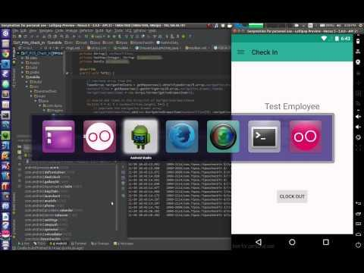
DEMO

